Slide 1
Saving the Streets
By Tessa Link

Slide 2
Background
I chose to explore if there was a better solution to melting ice when it’s slippery outside. The thing I hate most about driving is the potholes and the salt is a reason for that. Over time because of the giant amounts of salt we put on the roads it starts to corrode the street and cause potholes. Along with damaging the street it can also cause you car to had severe rust damage. Also the chemicals in the salt are bad for the environment because it is polluting the runoff that comes from after the ice melts and that runoff eventually flows into our rivers then our water systems.

Slide 3
Variables
Independent Variable: The liquid that the ice is melting in
Dependent Variable: The rate of ice melting
Constant Variable: Amount of liquid, the temperature of the room, the temperature of the liquid, the amount of liquid use to freeze the ice, type of container

Slide 4
Problem
The salt that we put down to melt ice is hurting the environment. Also the salt is damaging our roads and cars. If I can find a better way to do this it could save money and stop a lot of pollution and damage.

Slide 5
Hypothesis
My hypothesis that the salt water will melt the ice faster than baking soda water, vinegar, prune juice, normal tap water and sparking water.

Slide 6
Materials
Liquids: Tap water, sparkling water, baking soda water, salt water, vinegar and prune juice
Plastic containers, measuring cup, ice, freezer, plastic cups

Slide 7
Procedure
For each liquid that you need three containers each filled with 350ml of the liquid.
Fill cups with 250ml have one per container then freeze over night.
Once the water is frozen put one piece of ice in each container.
Every hour collect data.

Slide 8
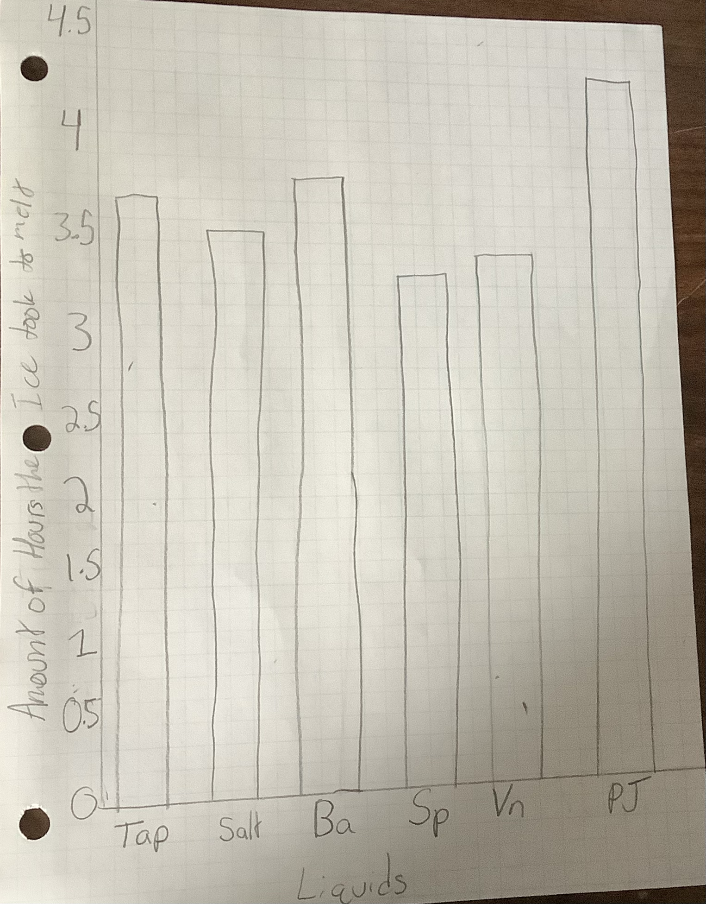
Data

Slide 9
Conclusion
My hypothesis of the ice with melt the fastest in salt water was incorrect. The sparkling water melted the ice the fastest. The salt water was not the most effective showing that it is not the most efficient therefore not the best choice so we should stop using it on the roads. It’s bad for the roads, cars and the environment and the experiment proves that it didn’t even work the best so we should stop using the salt.

Slide 10
Bibliography
https://www.uniquepavingmaterials.com/road-salt-cause-potholes-road-deterioration/
https://www.bridgestonetire.com/learn/maintenance/pros-and-cons-of-using-road-salt-in-winter/
https://www.epa.gov/snep/winter-coming-and-it-tons-salt-our-roads
https://www.nytimes.com/2022/01/07/climate/road-salt-water-supply.html

