Slide 1
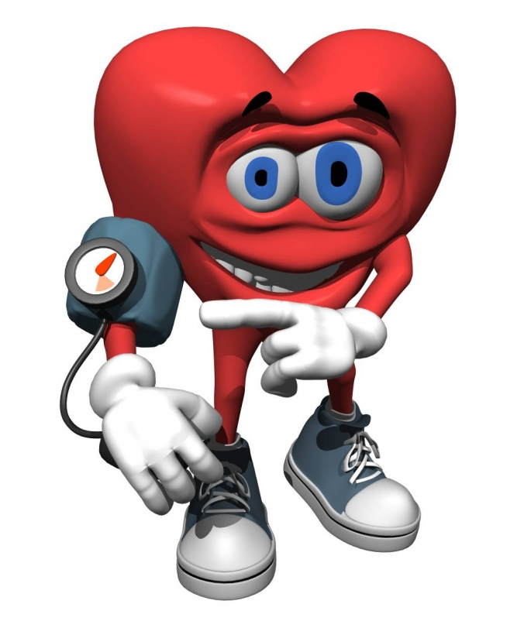
How does Exercise affect blood pressure?

Slide 2
background
The topic I decided to choose was how exercise affects your blood pressure. Everyone exercises and everyone feels tired, so I wanted to see if your blood pressure gets higher, lower or stays the same.
The numbers that you see when you measure blood pressure are called systolic pressure, which is the upper number, and diastolic pressure, which is the lower number. Systolic pressure is what indicates the pressure in your arteries when your beats and pumps out blood. Diastolic pressure is the reading of the pressure in your arteries between beats of your heart.
Blood pressure is measured in mm Hg, which means millimeters of mercury. In medicine, mercury is used as the standard unit of measurement for pressure.

Slide 3
Variables
Independent Variable (IV) – Three people exercising
Dependent Variable (DV) – Blood pressure after exercise
Constant Variable (CV) – The distance ran (500 m)

Slide 4
Problem
Does increasing aerobic activity lead to an increase in heart rate?

Slide 5
hypothesis
If a person performs an aerobic exercise (running 500 m) for 5 minutes, then their blood pressure will rise.

Slide 6
Materials and other resources
Blood pressure monitor
Timer
Three subjects of different age (12, 40, 70)
Distance of 500 m marked out.

Slide 7
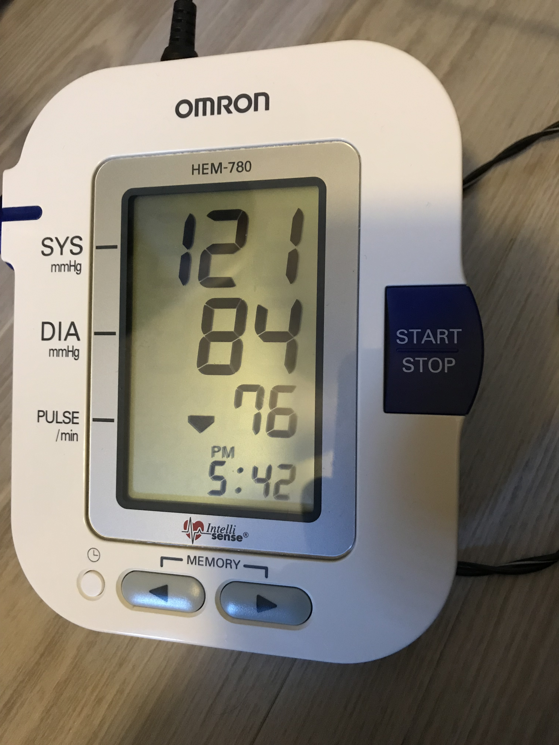
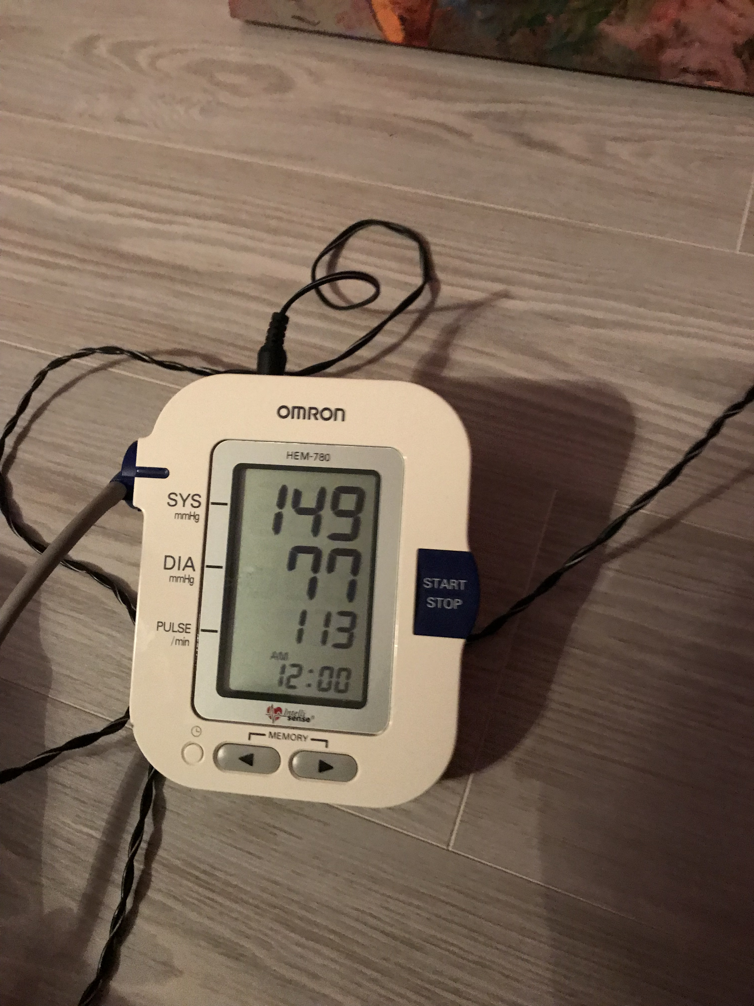
procedure
The experiment is repeated three times.
Choose three subjects for the experiment
Take and record the pre-exercise blood pressure on all three subjects to use as a control.
Subjects jogged the distance of 500m as quickly as possible
Immediately after exercise, blood pressure was taken again with blood pressure devise.
Results were recorded
Subjects were given 24 hours to recover then tested two more times with 24 hours of rest in between.
Example before and after blood pressure:

Slide 8
data / observations
Data documented after exercise is shown on the table:
 | Before | After | Increase/decrease | Average for each person
Person 1 - Trial 1 | 121/84 | 149/77 | 28/-7
Person 1 - Trial 2 | 120/82 | 151/84 | 31/2 | 28/-3
Person 1 - Trial 3 | 124/83 | 148/80 | 24/-3
Person 2 - Trial 1 | 123/85 | 154/86 | 31/1
Person 2- Trial 2 | 123/83 | 151/88 | 28/5 | 29/3
Person 2- Trial 3 | 125/84 | 153/87 | 28/3
Person 3 - Trial 1 | 141/72 | 180/101 | 39/29
Person 3 - Trial 2 | 140/70 | 178/100 | 38/30 | 38/28
Person 3 - Trial 3 | 138/74 | 176/98 | 38/24

Slide 9
Data / observations

Slide 10
conclusion
The results proved my hypothesis, of if a person performs a aerobic exercise (running 500 m) for 5 minutes then their blood pressure will rise, to be correct. If a person does aerobic exercise, blood pressure will rise. Blood pressure increased by exercise does not usually pose a health risk, as it comes down quickly. However, regularly high blood pressure can cause heart issues, shortness of breath and many other health issues and medical attention would be necessary.

Slide 11
Bibliography
"Blood Pressure Before & After Exercise" Livestrong, Livestrong, August 14 2017, https://www.livestrong.com/article/425759-blood-pressure-before-after-exercise/
"Should My Blood Pressure Be 120/80 Even After Exercise?“ Verywellhealth, Verywellhealth, February 23 2018,https://www.verywell.com/should-my-blood-pressure-be-12080-even-after-exercise-1764088
"High Blood Pressure Learning Centerhttp“ AARP, AARP //healthtools.aarp.org/learning-center/featured/high-blood-pressure
"Measuring Blood Pressure” CDC, CDC, https://www.cdc.gov/bloodpressure/measure.htm
“Understanding Blood Pressure” American Heart Association, American Heart Association, February 19 2018, http://www.heart.org/HEARTORG/Conditions/HighBloodPressure/KnowYourNumbers/Understanding-Blood-Pressure-Readings_UCM_301764_Article.jsp#.WpsRq0xFx9A

