Slide 1
Thrown Away Insulation
This project is to reuse commonly thrown away materials as insulation.
My target audience is anybody who needs insulation.

Slide 2
Background Information
In a previous experiment called Insulastic, I reused plastic, plastic bags, and a mix of the two as insulation. The plastic bags worked the best. I would like to expand on that project to see if any other commonly thrown-away materials are better than the plastic bags. I will use rubber tire bits, foam and polyfill as Thrown Away Insulation. I am also improving Insulastic by using a plexiglass box to test instead of a wooden one. The wood for the box was at least ¾ in. wide, and I think the wood helped the insulation keep the heat trapped.
The purpose of this experiment is to test these other materials (rubber, foam and polyfill) as possible Thrown Away Insulation. The most common material used right now as insulation is fiberglass. Fiberglass is almost impossible to recycle and can’t decompose. This material is also very dangerous to the lungs, eyes, and skin. The reason is because the fiberglass particles (small pieces of glass) can be inhaled and cause respiratory ailments. It will also cause your eyes and skin to itch.

Slide 3
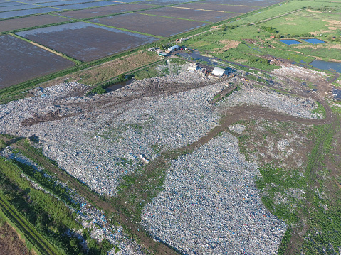
Problem and Hypothesis
Landfills are all over the world. There are over 1,250 landfill facilities in the U.S. alone. They release CO2 and methane gas which are both greenhouse gases. These greenhouse gases contribute to global warming. Landfills also take up lots of valuable space. For example, the size of an average landfill is 600 acres. Trash also ends up in the oceans and kills marine life. It is estimated by the Sea Turtle Conservancy that over one million marine animals die per year from trash in the ocean.
A variety of materials and garbage can be found in landfills. Aside from plastic, the most commonly thrown-away material, rubber, foam and polyfill also contribute to landfills and trashcans.
Hypothesis: The hypothesis for this current experiment is that the polyfill Thrown Away Insulation will do better than the other materials, including the plastic bags.

Slide 4
Independent and Dependent Variables, Control and Constants
Independent Variable: Type of insulation.
Dependent Variables: The temperature in the testing box.
Constants:
Heat of the bread warmer
Amount of insulation
Controls: The negative control was no insulation to see how the temperature in the box decreases without insulation. The positive control was fiberglass insulation to see how the temperature in box decreases with real insulation.
The testing box
The thermometer

Slide 5
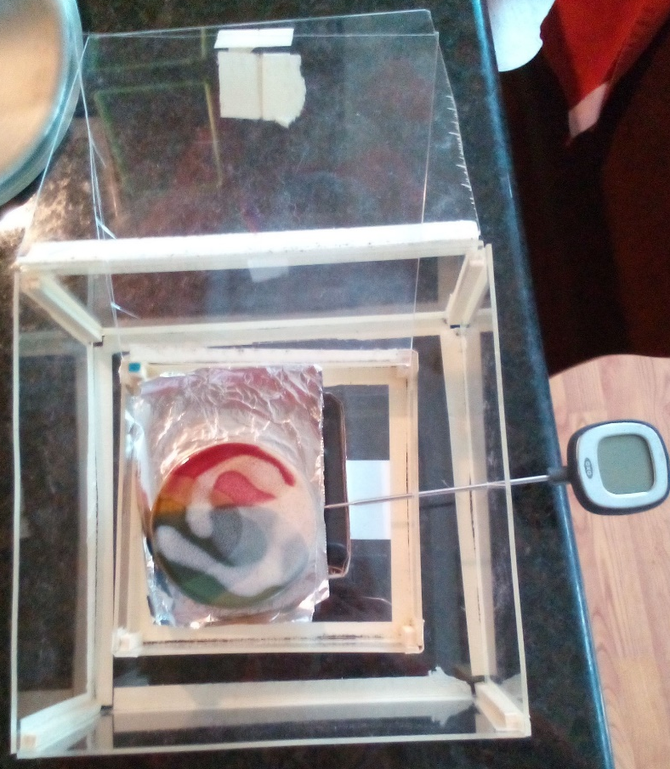
Imagine and Plan
Design #1- Rubber mulch
Design #2- Foam
Design #3- Polyester Polyfill
Design #4- No insulation
Design #5- Fiberglass insulation
Design #6- Plastic Bags
The Thrown Away Insulation will be tested in the new testing box (See side picture). The Thrown Away Insulation will be put in between the two boxes and then closed with the lid of the larger box. The testing box is made out of plexiglass.

Slide 6
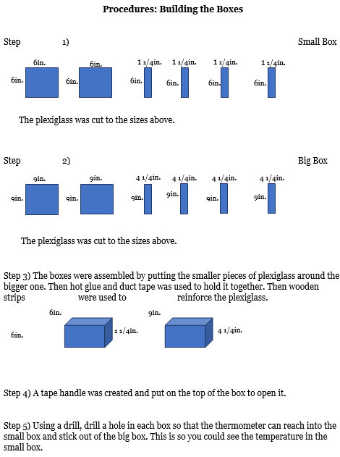
Create
Materials needed to make the testing boxes are plexiglass, duct tape, small wooden strips, drill, hot glue and cardboard.
I used the cardboard as a stand to hold the small box up.
The materials for testing are, the testing boxes, digital thermometer, timer, notebook, pencil, a bread warmer and the Thrown Away Insulation.
Steps to prepare the Thrown Away Insulation:
Step 1. The rubber mulch was gathered.
Step 2. The foam was gathered and cut up into rectangle shapes.
Step 3. The polyfill was gathered.

Slide 7
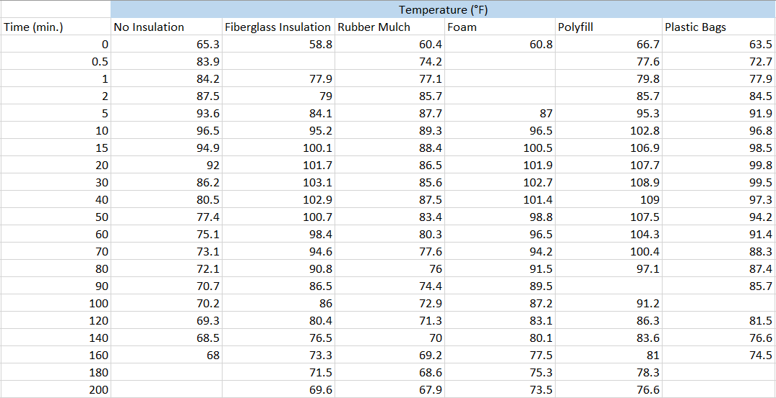
Data Table
Calculations:
No insulation- Start: 65.3 Highest point: 96.5 Temperature difference: 31.2
Fiberglass insulation- Start: 58.8 Highest point: 103.1 Temperature difference: 44.3
Rubber mulch- Start: 60.4 Highest point: 89.3 Temperature difference: 28.9
Foam- Start: 60.8 Highest point: 102.7 Temperature difference: 41.9
Polyfill- Start: 66.7 Highest point: 109 Temperature difference: 42.3
Plastic Bags- Start: 63.5 Highest point: 99.8 Temperature difference: 36.3

Slide 8
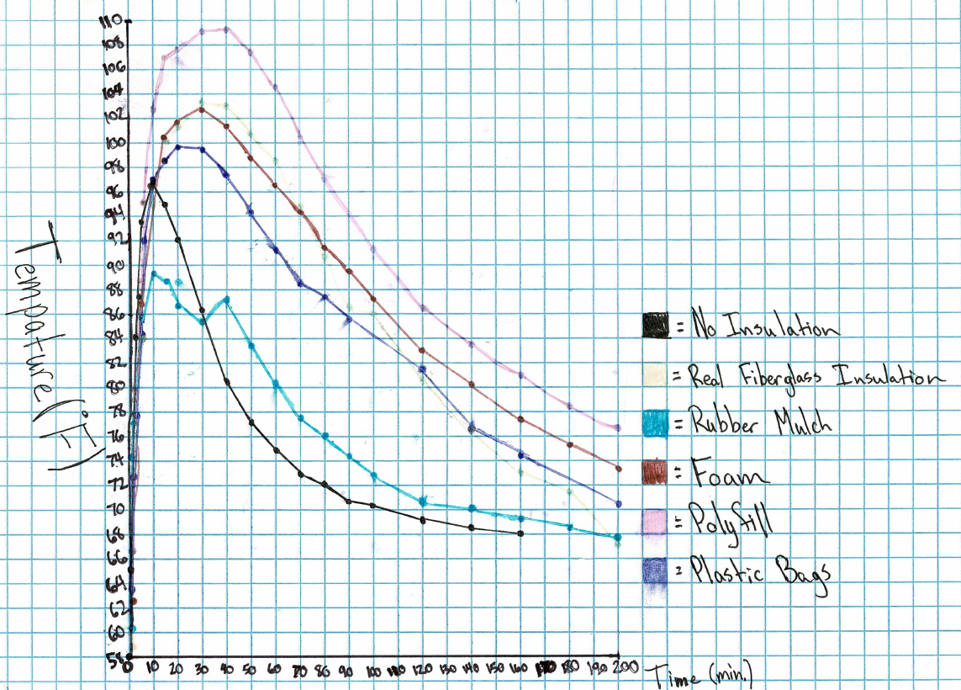
X-axis
Graph
Y-axis

Slide 9
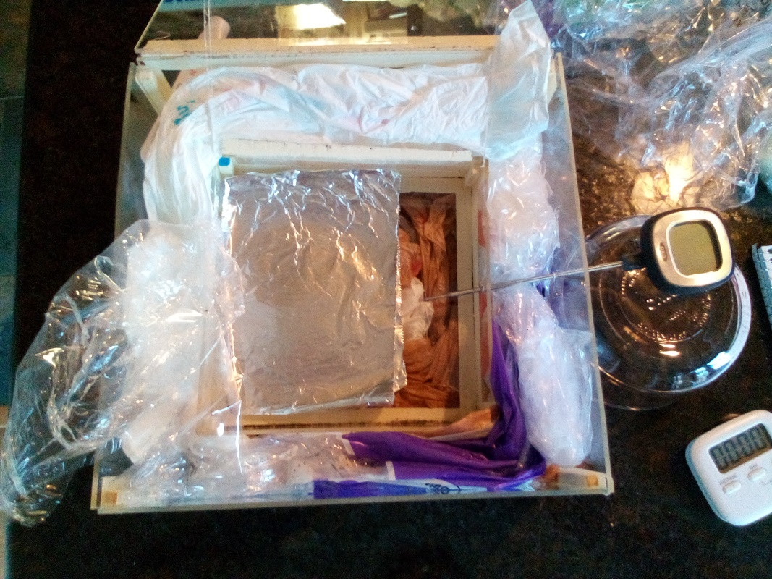
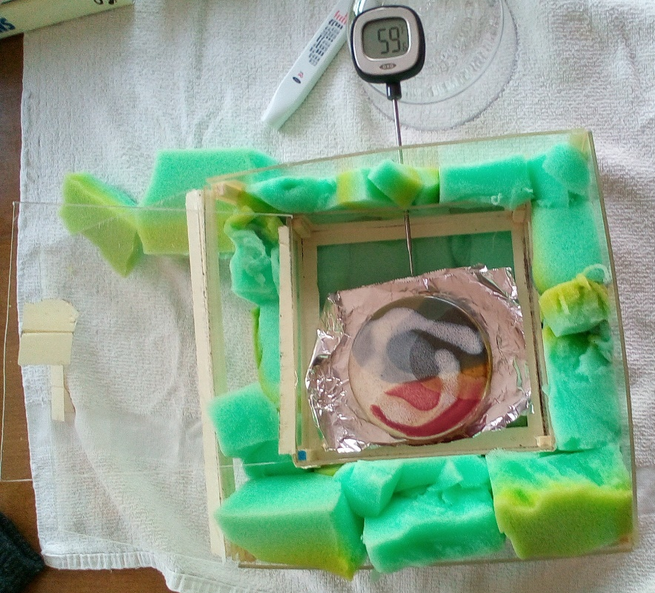
Results and Conclusion
Lectern
Results: The polyfill Thrown Away Insulation was always about 3°F below the real fiberglass insulation. So, the polyfill did the best out of all of the Thrown Away Insulation. It also did better than the plastic bags as well which was the best insulation in the previous project. The worst insulation was rubber mulch which only went up to 89°F.
Conclusion: In conclusion, Thrown Away Insulation solves the problem of common materials ending up in landfills. Its purpose was to reuse some of the most commonly thrown away materials and reuse them as insulation. The polyfill also did better than the plastic bags from the recent project. So, there fore the polyfill insulation is a successful insulation and can be used as an alternative to fiberglass insulation as insulation. I could improve this project by testing other polyfill types.

Slide 10
Sites:
https://www.colorado.edu/ecenter/2021/04/15/hidden-damage-landfills
https://lmacademics.com/wp-content/uploads/Vivian-Li.pdf
https://www.statista.com/statistics/186346/number-of-landfills-in-us-municipal-solid-waste/
https://greendiningalliance.org/2015/10/8-reasons-to-ban-styro-foam/
https://www.playgroundprofessionals.com/surfaces/rubber/life-recycled-tires-road-rubber-rubber-mulch
https://blogs.colgate.edu/sustainability/2011/11/10/styrofoam-why-it-is-harmful-alternatives/
https://conserveturtles.org/information-sea-turtles-threats-marine-debris/
https://stacker.com/stories/2682/how-long-it-takes-50-common-items-decompose
https://wonderopolis.org/wonder/what-happens-to-old-tires
https://www.popularmechanics.com/cars/car-technology/a22553570/waste-tires/
https://recyclenation.com/2014/09/recycle-fiberglass/
https://ecofriendlycrafts.com/blogs/green-crafting/alternative-stuffings-for-all-your-projects

