Slide 1
Is there a pattern to the way you draw?

Slide 2
A little more context:
This experiment is to see if there is any connection to the way you write/ draw things and to see if there is a reason to this.
The way this works is I asked a series of people to draw and write things like: stars, letters, numbers, cursive, squares, trapezoids, ext. Next I compare the data to attempt to find a pattern.

Slide 3
Why I chose this project:
I was drawing stars because I was bored when I asked my table partner to draw a star to see how she wrote it, she wrote it differently so I started asking more people to draw it. Then I asked my teacher to draw one and she said it would be interesting to investigate handedness for a science fair project. I also stuck with it because I liked to do something that had to with you mentally and the way your brain works since I never really see that at science fairs. Research shows that being left handed or right handed shows a difference.

Slide 4
Testable Question Hypotheses
Does learned behavior affect common tasks?
My hypothesis is that there’s a connection to determine that learned behavior affects common tasks.

Slide 5
Variables & constants
My independent variable is person drawing the star
My dependent variable is how they write it.
Constant: shape, gender, and grade level.

Slide 6
Materials & procedure
Materials: paper and something to right with.
Procedure: 2 stars, 1 square, 1 trapezoid, numbers 1-10, the letter Q, a bunch of circles, I am in cursive, the following letters: L Z N I

Slide 7
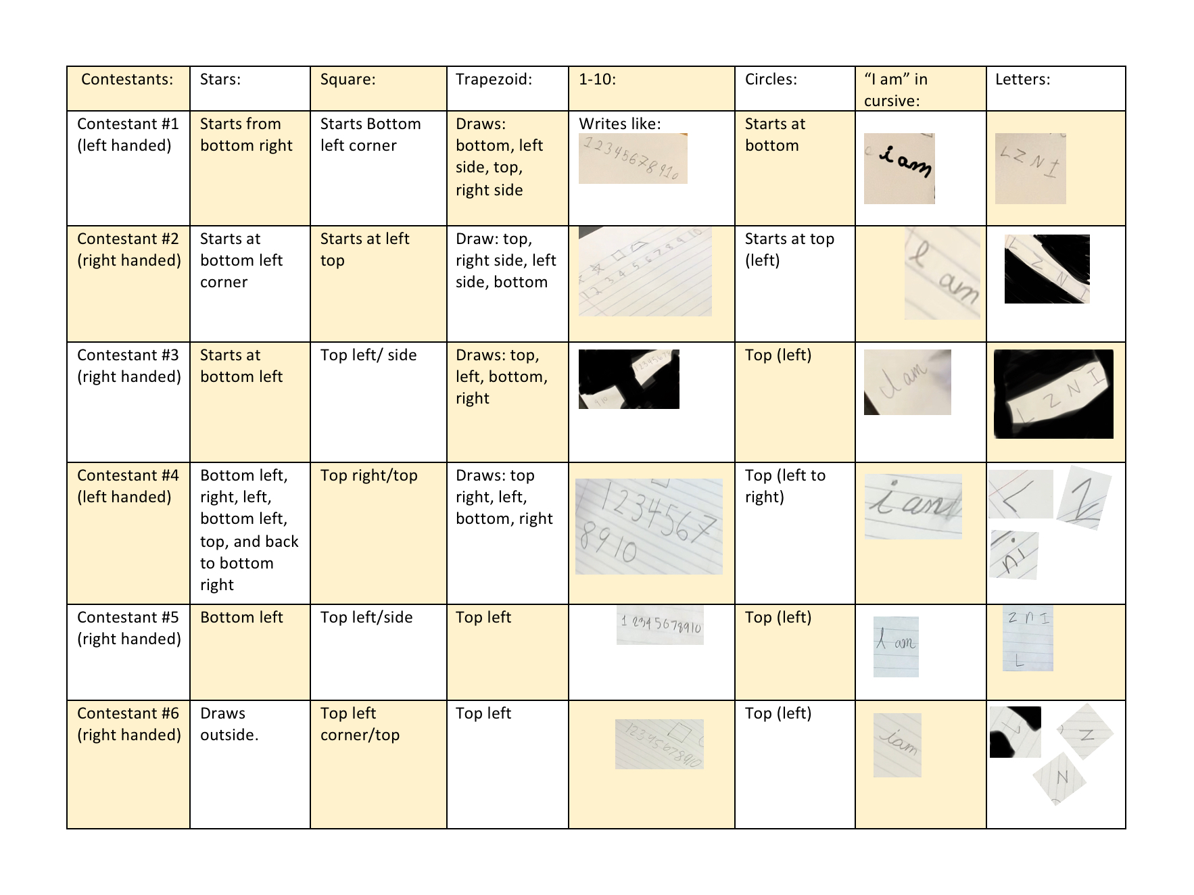
Data table

Slide 8
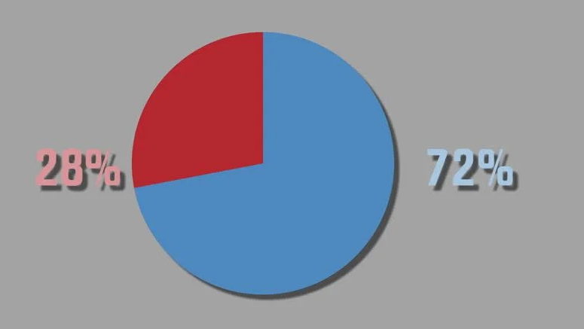
Pie chart
Same Way of Writing
Left Hand
Right Hand

Slide 9
My conclusion
So in conclusion, I found that many right handed people who most likely have been taught how to Write do wright very similar, as to left handed people who write uniquely because they weren’t taught how to. The reasoning for this is most teachers only teach the right handed children to right like they have becouse they can show examples and help better.

Slide 10
Worked sources
https://www.cmu.edu/teaching/designteach/teach/instructionalstrategies/writing/poorlyprepared.html

